Slide 1

Department of Computer Engineering
Introduction to Data Structures
Data Structures
Sem 3
3130702
Unit #1
Ravikumar Natarajan

Slide 2
Data Management concepts
Data types – primitive and non-primitive
Performance Analysis and Measurement (Time and space analysis of algorithms)
Types of Data Structures
Linear & non-linear Data Structures
Highlights

Slide 3
Define and classify various data structures, storage structures and common operations on them
Course Outcome

Slide 4
A program should give correct results but along with that it should run eﬃciently.
Data Management Concepts
Eﬃcient program executes:
Minimum time
Minimum memory space
To write eﬃcient program we need to apply Data management concepts.

Slide 5
Data Management concept includes,
Data collection
Organization of data in proper structure
Developing and maintaining routines for quality assurance
Data Management Concepts
“A data structure is a particular way of storing and organizing data in a computer so that it can be used eﬃciently.”

Slide 6
When selecting DS, must perform below steps:
Analysis of the problem to determine basic operations like insert/delete/search a data in DS
Quantify the resource constraints for each operation
Select DS that best meets these requirements
Data Structure
When developing an application:
First – data and operations, that are to be performed
Second – representation of data
Third – implementation of that representation

Slide 7
A data type is a classiﬁcation of data, which can store a speciﬁc type of information.
Primitive data types
Non-Primitive data types
Data Types
Primitive data types are predeﬁned, supported by C language. e.g. int, char, ﬂoat, double
Non-Primitive data types are not deﬁned by C language, but are created by the programmer. e.g. Stack, Queue, Linked List, Tree, Graph
They are created using the basic data types.

Slide 8
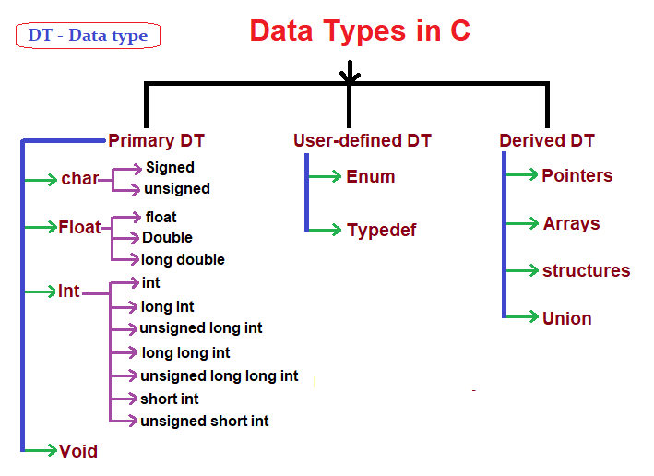
Data Types

Slide 9
1. Arrays
An array is a data structure consisting of a collection of similar data elements, each identiﬁed by one array index.
The elements in array are stored in consecutive memory locations.
Array Syntax: int marks[5];
Types of Data Structure
Elements
marks[0]
marks[1]
marks[2]
marks[3]
marks[4]
Array
80 | 60 | 78 | 56 | 87
Index
0
1
2
3
4

Slide 10
1. Arrays
Limitations of Arrays:
Fixed size
Data elements are stored in contiguous memory locations which may not be available always!
Adding and removing of elements is tough because of shifting the elements from their positions.
Types of Data Structure

Slide 11
2. Linked List
Consisting of a group of nodes which together represent a sequence.
Under the simplest form, each node is composed of a data and a reference (in other words, a link) to the next node in the sequence.
Types of Data Structure
Node
Data
Reference
This structure allows for eﬃcient insertion or removal of elements from any position in the sequence.

Slide 12
2. Linked List
A linked list whose nodes contain two ﬁelds:
an integer value and a link to the next node.
Head/Start
D1 |  |  |  | D2 |  |  |  | D3 | NULL
Types of Data Structure
The last node is linked to a terminator (NULL pointer) used to signify the end of the list.
Advantage:
Provides quick insert and delete operations
Disadvantage:
Slow search operations and requires more memory space.

Slide 13
3. Stacks
Stack can be represented as a linear array.
Every stack has a variable TOP associated with it, to store the address of the topmost element of the stack.
Types of Data Structure
D3
D2
D1
4
3
Top
2
1
0
Stack

Slide 14
3. Stacks
A stack is a last in, ﬁrst out (LIFO) data structure.
If TOP = NULL, then it indicates stack is empty
If TOP = MAX, then it indicates stack is full.
Types of Data Structure
D3
D2
D1
D5
D4
D3
D2
D1
4
4
Top
4
3
3
3
2
Top
2
2
1
1
1
0
0
0
Top
Empty Stack
Stack With 3 Data
Full Stack

Slide 15
3. Stacks
Elements are removed from the stack in the reverse order to the order of their addition:
therefore, the lower elements are those that have been on the stack for longest time.
Types of Data Structure
Advantage: last-in ﬁrst-out (LIFO) access.
Disadvantage: Slow access to other elements.

Slide 16
4. Queue
Queue is a data structure in which data can be added to one end and retrieved from the other.
You can think of it as a line in a grocery store.
The ﬁrst one in the line is the ﬁrst one to be served. Just like a queue.
A queue is also called a FIFO (First In First Out) to demonstrate the way it accesses data.
Types of Data Structure
Advantage: Provides ﬁrst-in, ﬁrst-out data access.
Disadvantage: Slow access to other items.

Slide 17
5. Trees
A tree is a widely used data structure that simulates a hierarchical tree structure with a set of linked nodes.
Every tree has a root element pointed by a root pointer.
If root = NULL, tree is empty.
A simple unordered tree:
Types of Data Structure
Root
7
4
9
2
5

Slide 18
5. Trees
In binary tree every node contains a left pointer, a right pointer and a data element.
Root
7
Types of Data Structure
4
 | 9
 | 2
 | 5
Advantage: Provides quick search, insert, delete operations.
Disadvantage: Complicated deletion algorithm.
Example: Family Tree

Slide 19
6. Graph
A graph is a data structure that is meant to implement the graph concepts from mathematics.
It is basically a collection of vertices(nodes) and edges that connect these vertices.
Types of Data Structure
1
2
5
3
4

Slide 20
6. Graph
A graph is often viewed as a generalization of the tree structure, where complex relationship can be represented.
Types of Data Structure
Advantage: Best models real-world situations.
Disadvantages: Some algorithms are slow and very complex.

Slide 21
1. Linear Data Structure
Elements are stored sequentially
We can traverse either forward or backward
Examples: Arrays, Stacks, Queues, Linked list
Types of Data Structure
2. Non-linear Data Structure
Not stored in sequential order
Branches to more than one node
Can’t be traversed in a single run
Examples: Tree, Graphs

Slide 22
ADT is the way we look at a Data Structure, focusing on what it does and ignoring how it does its job.
In C for eg. FILE
Examples: Stack, Queue
Abstract Data Type
Implementation is hidden
Whenever end user uses Stack, he is concerned about only the type of data and operations that can be performed on it.
Fundamentals of how the data is stored, is invisible to users.
They will have push(), pop(), etc. functions only.

Slide 23
“A formally deﬁned procedure for performing some calculation”
An algorithm provides a blueprint to write a program to solve a particular program.
Algorithm is a set of instructions that solve a problem.
It is possible to have multiple algorithms to tackle the same problem, but choice depends on time and space complexity.
Algorithm

Slide 24
Any algorithm will be having ﬁnite steps.
Algorithm exhibits three key features:
Key features of an Algorithm
Sequence
Decision
Repetition

Slide 25
Exercise:
AIM: Write an algorithm to ﬁnd sum of ﬁrst N numbers.
Step1: Input N
Step2: SET ITR = 1, SUM = 0
Step3: Repeat Step 4 and 5 While ITR<=N Step4: SET SUM = SUM + ITR
Step5: SET ITR = ITR + 1 Step6: PRINT SUM
Step7: END
Algorithm

Slide 26
The analysis of algorithms is the determination of the number of resources (such as time and storage) necessary to execute them.
Time and Space Complexity
Time Complexity of an algorithm is basically the running time of a program, as a function of the input size.

Slide 27
Space Complexity of an algorithm is the amount of computer memory that is required during the program execution, as a function of input size.
The space needed by a program depends on:
Time and Space Complexity
Fixed Part: that varies from problem to problem. It includes instruction, constants, variables etc.
Variable Part: that varies from problem to problem. It includes space needed for recursion, dynamic value allocation to variables.

Slide 28
Best, Worst and Average cases of a given algorithm express what the resource usage is at least, at most and on average, respectively.
Best, Worst and Average case
In real-time computing, the worst-case execution time is often of particular concern since it is important to know how much time might be needed in the worst case to guarantee that the algorithm will always ﬁnish on time.

Slide 29
The term best-case performance is used in computer science to describe the way of an algorithm behaves under optimal conditions.
For example, the best case for a simple linear search on a list occurs when the desired element is the ﬁrst element of the list.
Best-case performance for algorithm

Slide 30
This denotes the behavior of the algorithm with respect to the worst-possible case of the input instances.
Worst-case running time of an algorithm is an upper bound on the running time for any input.
This provides an assurance that this algorithm will never go beyond this time limit.
Worst-case performance for algorithm

Slide 31
Running time of an algorithm is an estimate of the running time for an ‘average’ input.
It speciﬁes the expected behavior of the algorithm when the input is randomly drawn from a given distribution.
Average-case performance for algorithm

Slide 32
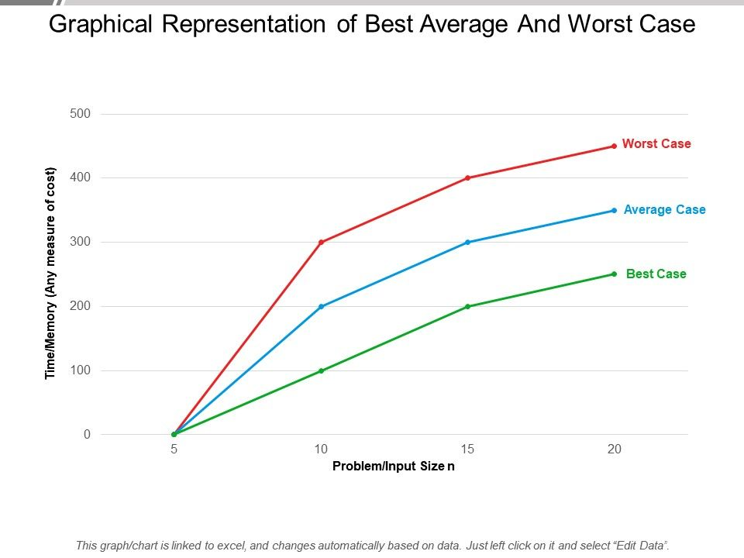
Graphical Representation of Best, Average and Worst Case
Notes:
Big O Notation Name Example(s)
O(1) Constant # Odd or Even number,
# Look-up table (on average)
O(log n) Logarithmic # Finding element on sorted array with binary search
O(n) Linear # Find max element in unsorted array,
# Duplicate elements in array with Hash Map
O(n log n) Linearithmic # Sorting elements in array with merge sort
O(n2) Quadratic # Duplicate elements in array **(naïve)**,
# Sorting array with bubble sort
O(n3) Cubic # 3 variables equation solver
O(2n) Exponential # Find all subsets
O(n!) Factorial # Find all permutations of a given set/string

Slide 33
There can be more than one algorithm to solve a particular problem.
One may require less memory space and one may require less CPU time to execute.
Hence, there exists a time-space trade-off among algorithms.
So, if space is a big constraint, then one might choose a program that takes less space at the cost of more CPU time.
On the contrary, if time is a major constraint then one might choose a program that minimum time to execute at the cost of more space.
Time-Space Trade-off

Slide 34
Time & Space Complexity can be expressed using function f(n), where n is the input size
Required when:
Expressing Time & Space Complexity
We want to predict the rate of growth of complexity as size of the problem increases
Multiple algorithms available, but we need to ﬁnd most eﬃcient

Slide 35
Expressing Time & Space Complexity
Most widely used notation to express this function f(n) is Big-Oh notation (O).
It provides upper bound for the complexity.

Slide 36
If a function is linear (without any loop or recursion), the running time of that algorithm can be given as the number of instructions it contains.
Running time may vary because of loops or recursive functions.
Algorithm Eﬃciency

Slide 37
To calculate the eﬃciency with single loop, we ﬁrst need to determine number of times the loop will be executed.
for(i=0; i<100;i++) statement block;
Here loop factor is 100. Eﬃciency is directly proportional to the number of iterations.
The general formula: f(n)=n
for(i=0; i<100;i+=2) statement block;
Linear Loops
Here, the number of iterations are just half the number of loop factor.
f(n) = n/2

Slide 38
Loops that contain inner loop.
In order to analyze nested loops, we need to determine the number of iterations each loop completes.
No. of iterations in inner loop * No. of iterations in outer loop = Total no. of iterations
Nested Loop

Slide 39
Number of iterations in inner loop is equal to number of iteration in outer loop.
for(i=0; i<10;i++) for(j=0; j<10;j++)
statement block;
Generalized formula: f(n) = n²
Quadratic Loop

Slide 40
Number of iterations in inner loop is dependent on outer loop.
for(i=0; i<10;i++) for(j=0; j<=i;j++)
statement block;
Dependent Quadratic Loop
The inner loop will execute as: 1 + 2 + . . . + 10 = 55 (Average is 5.5)
In general terms: (n+1)/2
Inner loop will iterate number of iterations in outer loop plus 1 divided by 2.
So, for overall of this: f(n) = n (n+1) / 2

Slide 41
Limitations of Big O Notation
Many algorithms are hard to analyze mathematically
Big O analysis only tells us how the algorithm grows with the size of the problem, not how eﬃcient it is
For Big O Notation, O(n²) and O(100000n²) are equal, but in real time this may be a serious concern
Big O Notation

Slide 42
Unit#2:
Linear Data Structures & their representation
Next Step
Array
Stack
Queue
Linked List

Slide 43
Thank You.

